Slide 1
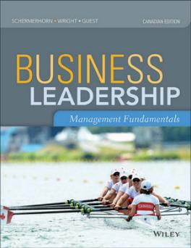
Chapter 4: planning processes and techniques

Slide 2

Planning Ahead — Chapter 4 Learning Goals
Understand how and why managers plan ahead
Understand the types of plans managers use
Understand various useful planning tools and techniques
Understand how can plans be well implemented

Slide 3
Why and how do managers plan?
Planning:
The process of setting objectives and determining how to best accomplish them
Objectives:
Identify the specific results or desired outcomes that one intends to achieve
Plan:
A statement of action steps to be taken in order to accomplish the objectives

Slide 4
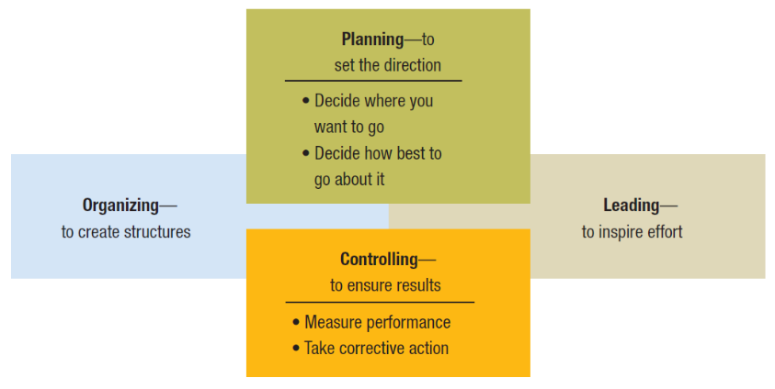
Figure 4.1 the roles of planning and controlling in the management process

Slide 5
Steps in the Planning Process
Define your objectives.
Determine where you stand in relations to objectives.
Develop premises regarding future conditions.
Analyze alternatives and make a plan.
Implement the plan and evaluate results.

Slide 6
Benefits of planning
Improves focus and flexibility
Improves action orientation
Improves coordination and control
Improves time management

Slide 7
Personal Time Management Tips
DO say “no” to requests that distract you from what you should be doing.
DON’T get bogged down in details that can be addressed later.
DO screen telephone calls, emails, and meeting requests.
DON’T let drop-in visitors or instant messaging use up your time.
DO prioritize your important and urgent work.
DON’T become calendar bound by letting others control your schedule.
DO follow priorities; do most important and urgent work first.

Slide 8
Types of Plans Used by Managers
Short-range and long-range plans
Short-range plans = 1 year or less
Intermediate-range plans = 1 to 2 years
Long-range plans = 3 or more years
People vary in their capability to deal effectively with different time horizons.
Higher management levels focus on longer time horizons.

Slide 9
Strategic and Tactical Plans
Strategic plans: set broad, comprehensive, and longer-term action directions for the entire organization.
Tactical plans: define what needs to be done in specific functions to implement strategic plans.
Production plans
Financial plans
Facilities plans
Marketing plans
Human resource plans
Functional plans: describe how different operations within the organization will help advance the overall strategy

Slide 10
Operational plans
Identify short-term activities to implement strategic plans.
Policies and procedures:
Policy
Broad guidelines for making decisions and taking action in specific circumstances.
Rules or procedures
Plans that describe exactly what actions are to be taken in specific situations.

Slide 11
Operational plans (cont’d)
Budgets:
Single-use plans that commit resources to activities, projects, or programs
Fixed, flexible, and zero-based budgets

Slide 12
Planning Tools and Techniques
Forecasting:
Making assumptions about what will happen in the future
Qualitative forecasting uses expert opinions
Quantitative forecasting uses mathematical and statistical analysis
All forecasts rely on human judgment
Planning involves deciding on how to deal with the implications of a forecast

Slide 13
Planning Tools and Techniques (cont’d)
Contingency planning:
Identifying alternative courses of action that can be implemented if circumstances change
Contingency plans anticipate changing conditions

Slide 14

Video: There's No Snow At The Winter Olympics?
There’s No Snow at the Winter Olympics?
(external link)
Notes:
Link: http://www.youtube.com/watch?v=_ObeaktMqq0

Slide 15
Planning Tools and Techniques (cont’d)
Scenario planning:
A long-term version of contingency planning
Identifying alternative future scenarios
Plans made for each future “worst-case” or “best-case” scenario

Slide 16
Video: Shell energy scenarios to 2050
Shell Energy Scenarios
(external link)
Notes:
Link: http://www.youtube.com/watch?v=jQ2uIPeiEYQ

Slide 17
Planning Tools and Techniques (cont’d)
Benchmarking:
Use of external and internal comparisons to better evaluate current performance and identify possible actions for the future
Adopting best practices of other organizations that achieve superior performance

Slide 18
Video: Spanish Fashion Retailer Zara's Parent Company Inditex Reports Rise in Profits and Expansion
Inditex Reports Rise in Profits and Expansion
(external link)
Notes:
Link: http://www.youtube.com/watch?v=fNgPYPMerEU

Slide 19
Implementing Plans to Achieve Results
Goal Setting:
Can make a big difference in how well management does by pointing people in the right directions and inspiring them to work hard.
Great goals are SMART:
Specific: target key results
Measurable: results can be assessed
Attainable: challenging yet realistic
Referred to: keep on the task at hand
Timely: linked to specific due dates

Slide 20
Goal Alignment
To make sure that goals and plans are well integrated across the many people, work units, and levels of an organization as a whole
Goals set anywhere in the organization should ideally help advance its overall mission or purpose

Slide 21
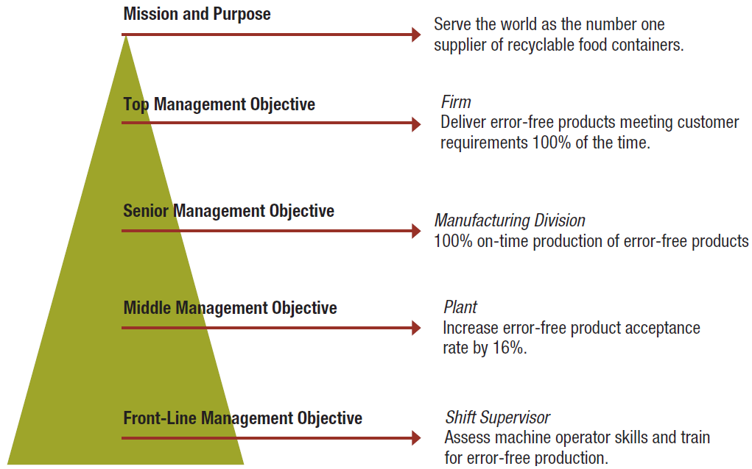
Figure 4.6 A sample hierarchy

Slide 22
Participation and involvement
Participatory planning requires that the planning process include people who will be affected by the plans and/or will help implement them
Benefits of participation and involvement:
Promotes creativity in planning
Increases available information
Fosters understanding, acceptance, and commitment to the final plan

Slide 23
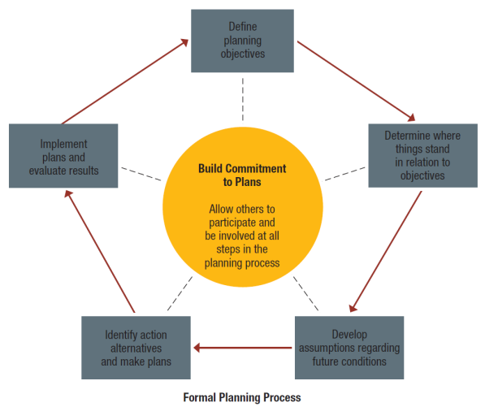
Figure 4.7 How participation and involvement help build commitments to plans

